Slide 1

Sarower Ahmmed

Slide 2
Introduction
The word maven comes from Hebrew, meaning "one who understands", based on an accumulation of knowledge.
Maven is build tool.

Slide 3
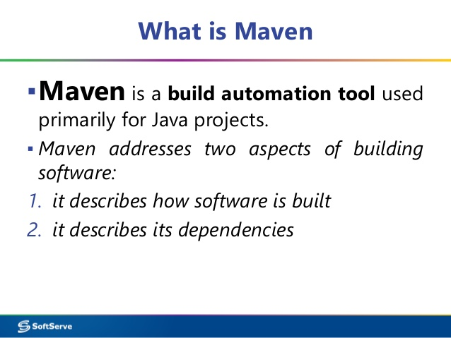

Slide 4
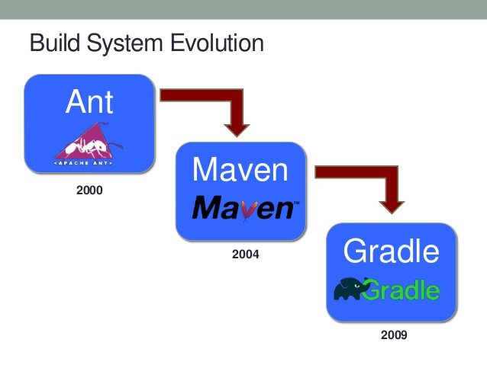
Popular build tools in market

Slide 5
What is build?
A build is a version of a program.
As a rule, a build is a pre-release version and as such is identified by a build number, rather than by a release number.
A 'build' is an attempt to compile all of the source code for the project into a set of executable binaries, that in turn get packaged into a final product.

Slide 6
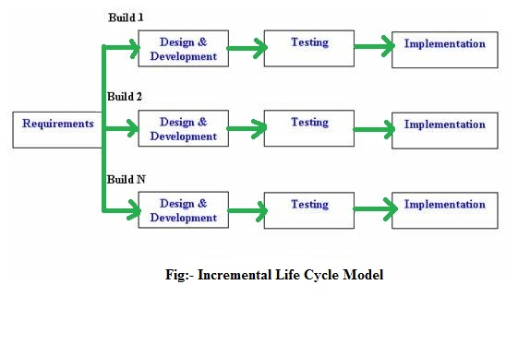

Slide 7
Maven’s Objectives
Making the build process easy
Providing a uniform build system
Providing quality project information
Providing guidelines for best practices development
Allowing transparent migration to new feature

Slide 8
Introduction to the Build Lifecycle
There are three built-in build lifecycles:
Default: The default lifecycle handles your project deployment
clean : the clean lifecycle handles project cleaning
Site: while the site lifecycle handles the creation of your project's site documentation.

Slide 9
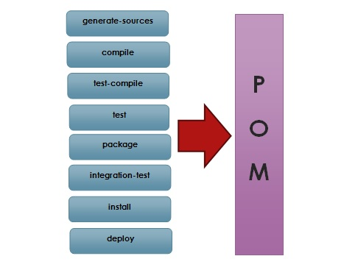
MavenDefault/ Build Life Cycle phases

Slide 10
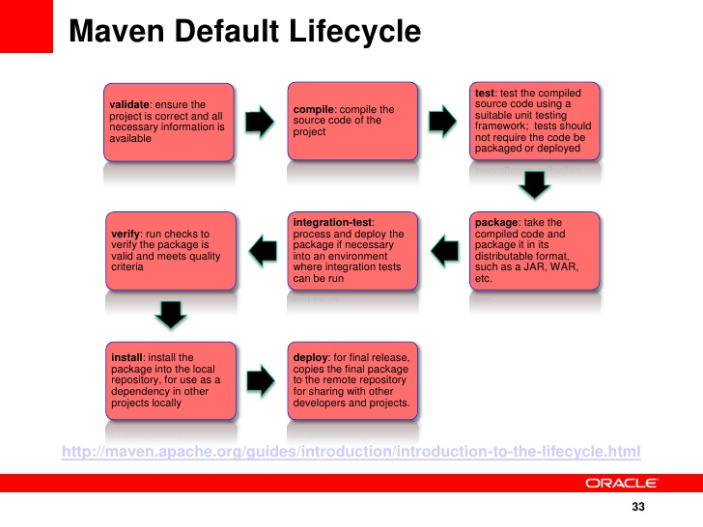

Slide 11
Clean Lifecycle
pre-clean execute processes needed prior to the actual project cleaning
clean remove all files generated by the previous build
post-clean execute processes needed to finalize the project cleaning

Slide 12
Site Lifecycle- generate reports
pre-site execute processes needed prior to the actual project site generation
site generate the project's site documentation
post-site execute processes needed to finalize the site generation, and to prepare for site deployment
site-deploy deploy the generated site documentation to the specified web server

Slide 13
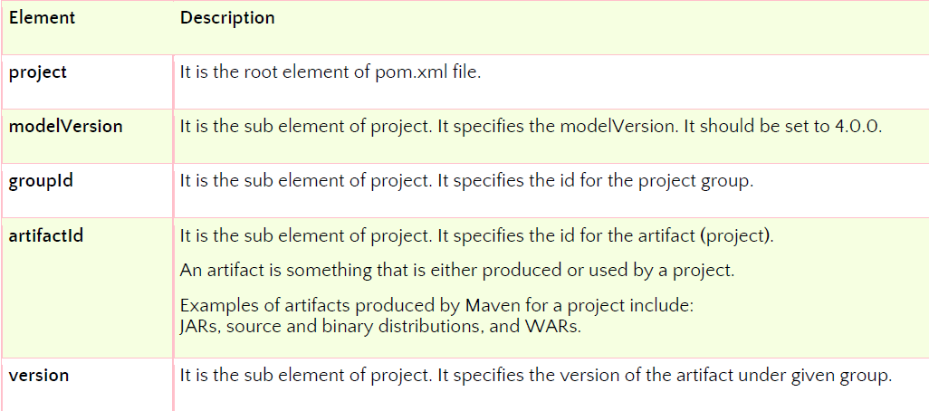
Maven project

Slide 14
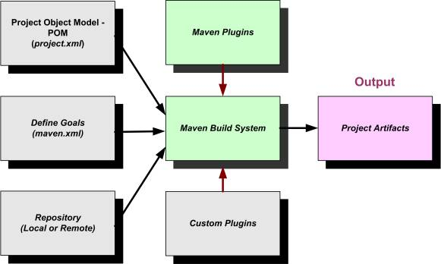

Slide 15
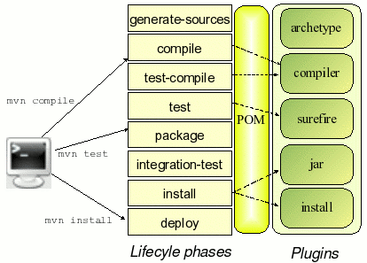

Slide 16
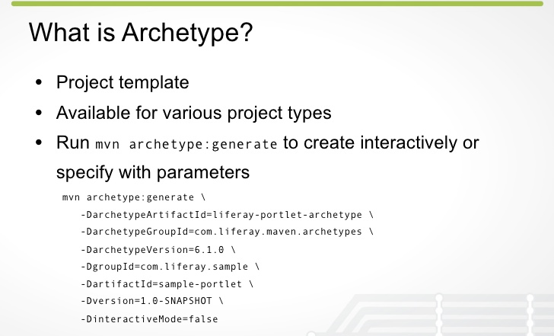

Slide 17
Artifact ID and Group ID
An artifact is a file, usually a JAR, that gets deployed to a Maven repository.
A Maven build produces one or more artifacts, such as a compiled JAR and a "sources" JAR.
Each artifact has a
  group ID (usually a reversed domain name, like com.example.foo),
  an artifact ID (just a name), and
  a version string.

Slide 18
Jar | WAR | ERA
Java archive file | Web Archives | Enterprise Archives
Group of .class file | specifically for web applications made from Servlets, JSPs, and supporting classes | contains all of the components that make up a particular J2EE application.
 | JSPs,Servlets,XML,CSS, HTML, javascript>> into a single zip file | Webserver (JSPs,Servlets,HTML,XML)+Enterprize/client(JMs,EJBs)>>into single zip file
 | A single file help to delivery and deployment web project easily | It’s a application server, means J2EE server
 | Each WAR file represent one web application | single zip file>>one enterprise application
 |  | ERA contain in build web server

Slide 19
Why Maven Plugins are used?
Maven plugins are used to
• Create a jar file
• Create war file
• Compile code files
• Unit testing of code
• Documenting projects
• Reporting

Slide 20
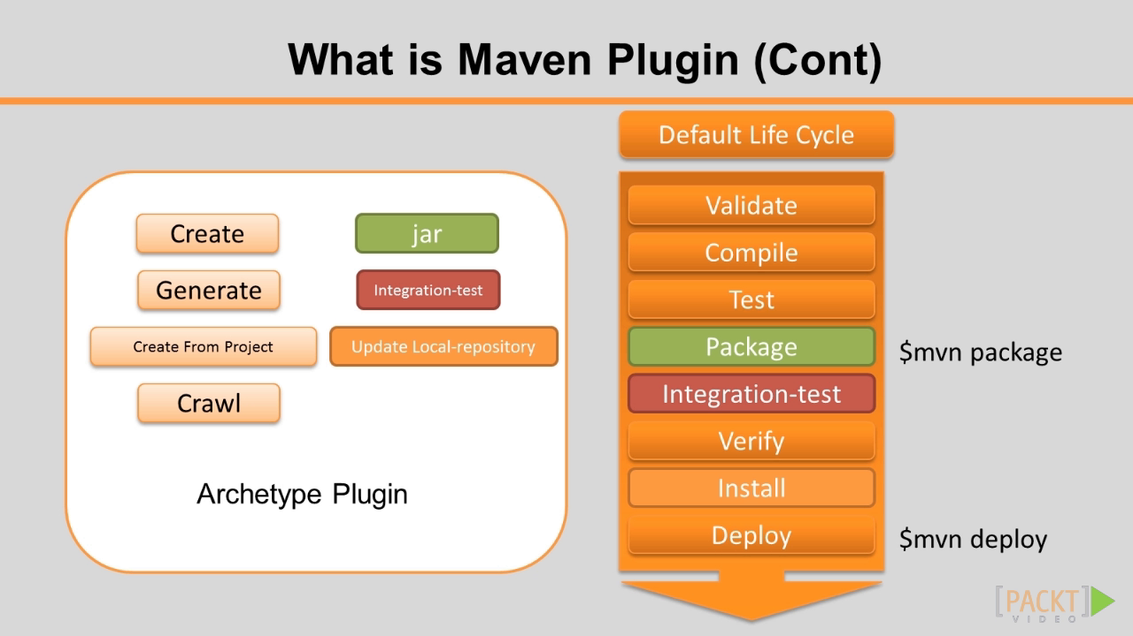

Slide 21
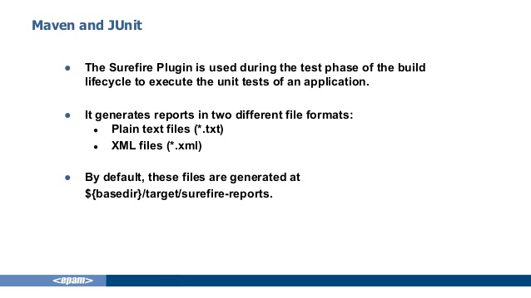

Slide 22
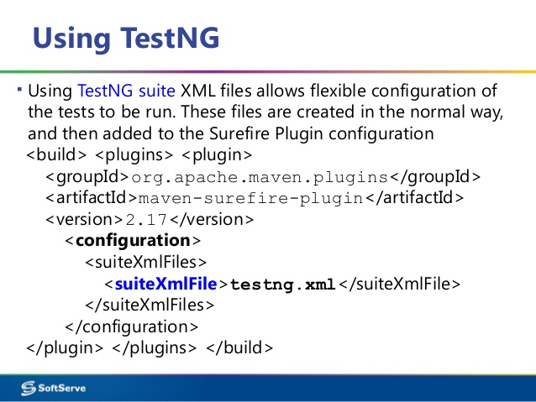

Slide 23
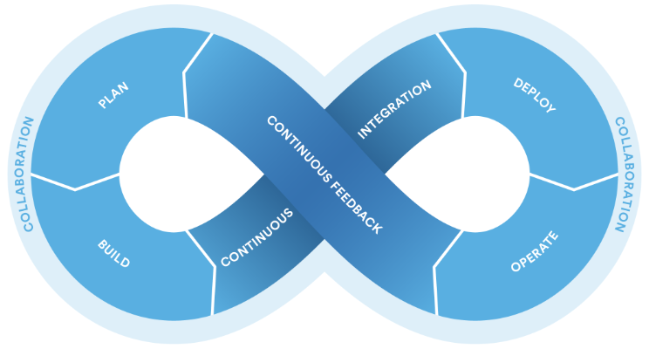
What is DevOps:
DevOps (development and operations) is an enterprise software development phrase used to mean a type of agile relationship between development and IT operations.

Slide 24
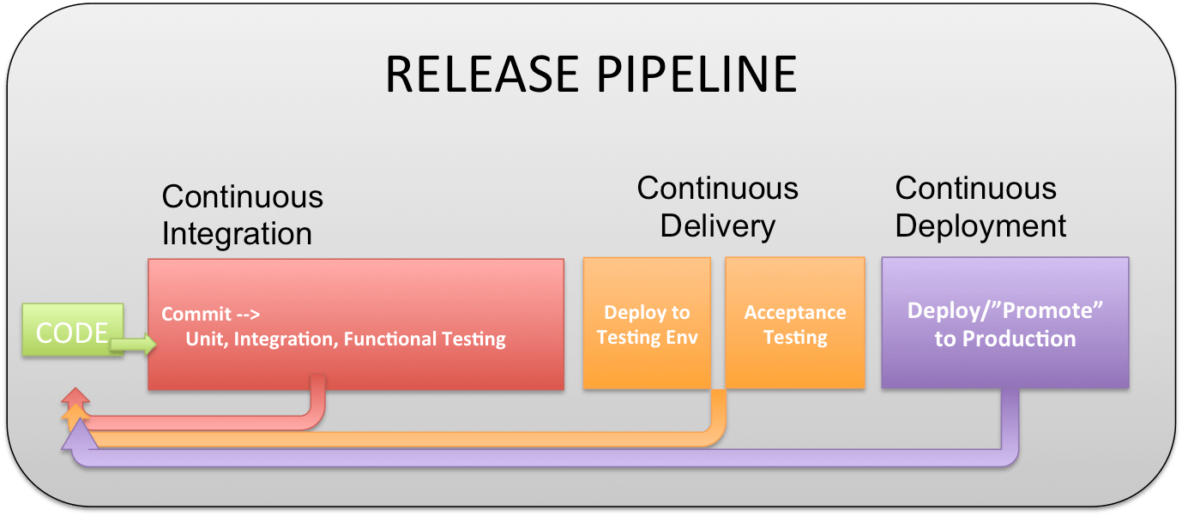
DevOps concept-

Slide 25
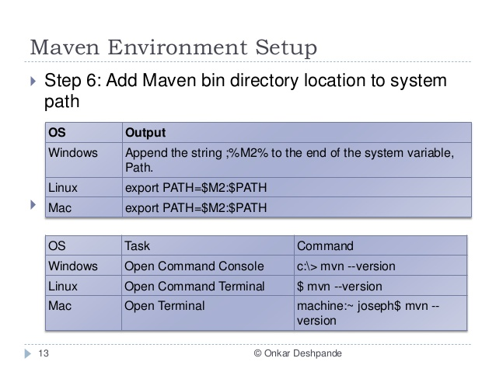
Maven setup (NO need now)

Slide 26
CMD
eclipse: clean
eclipse: eclipse
  Clean previous artifact and create eclipse project(.class+.project file)
mvn: clean
mvn: install
  Clean maven preious artifact and install all dependencies & jar for project
mvn: build
  Build the projrct(.class+ .project file)

Slide 27
mvn clean - First command deletes target directory and then builds all you code and
mvn install: install-file
installs artifacts/jar into local repository.
3. mvn eclipse:clean & eclipse:eclipse- build the project into eclipse project like structure.
Second command is completely different from the first one.
First, it deletes previously generated Eclipse files (like .project and .classpath and .settings) and
then generates new ones, thus, effectively updating them. It may be useful if you introduced some changes in pom.xml (like new dependencies or plugins) and want Eclipse to be aware of them.

Slide 28
How to get maven Debug info
CMD:
  mvn –X clean
How to get effective POM
  mvn effective:pom
How to get entire effective POM to print
  mvn help:effective-pom
How to get entire dependencyto print
  mvn dependency:tree

Slide 29
To see the archietype
Mvn acrhetype:generate

Slide 30
Maven Command from Eclipse
Maven Update – update the project with new jar and feature
Maven Clean – delete all old artifact and report from target folder
Maven installed – install all jar and plugin what the current project needed
Others –
Maven Build
Maven Test

Slide 31
Why maven in java project?
Maven allows uniform build system by
project object model (POM) and
a set of plugins
Dependence or jar or library file injection is easy
Allowing transparent migration to new features
Installation of new or updated plugins from third parties or Maven itself has been made trivial for this reason.

Slide 32
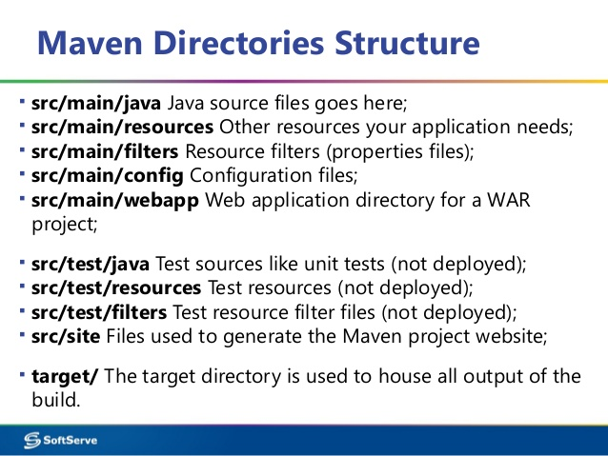

Slide 33
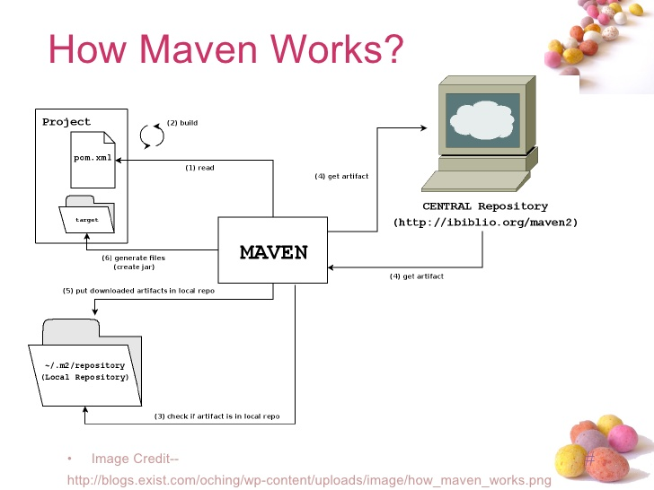

Slide 34
Explain what is Maven Repository? What are their types?
A Maven repository is a location where all the
  project jars, library jars, plugins or any other particular project related artifacts are stored and can be easily used by Maven.
Maven repo types are
  Local – working PC
  central and remote – at certral maven repo

Slide 35
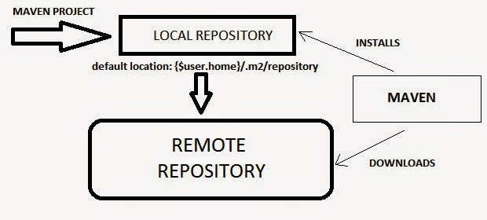

Slide 36
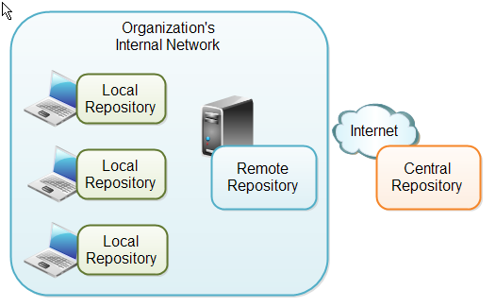

Slide 37
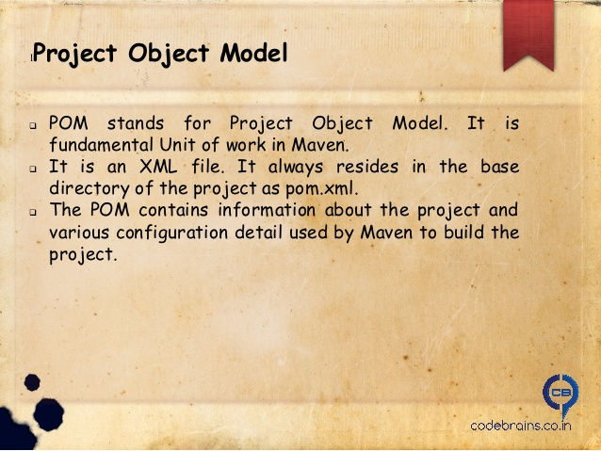
Explain what is POM?

Slide 38
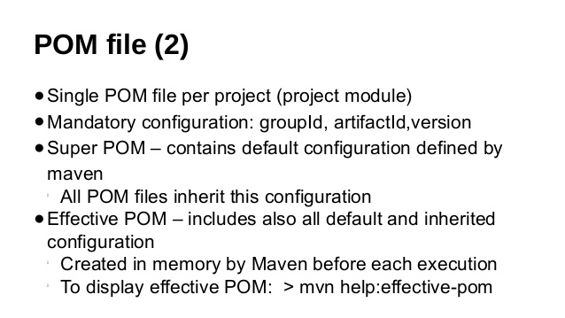

Slide 39
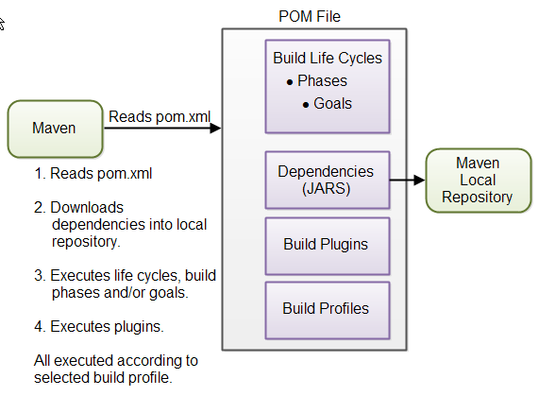

Slide 40
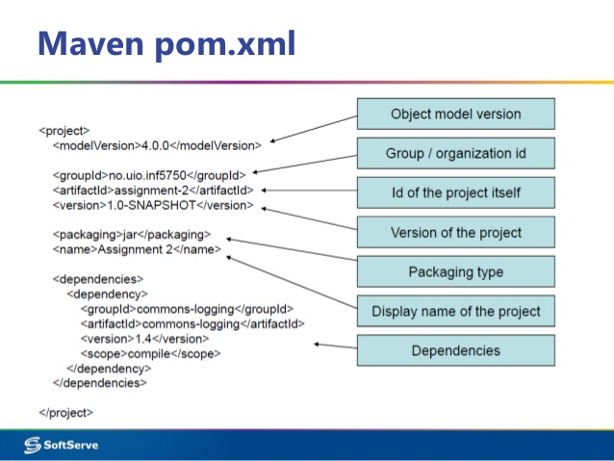

Slide 41
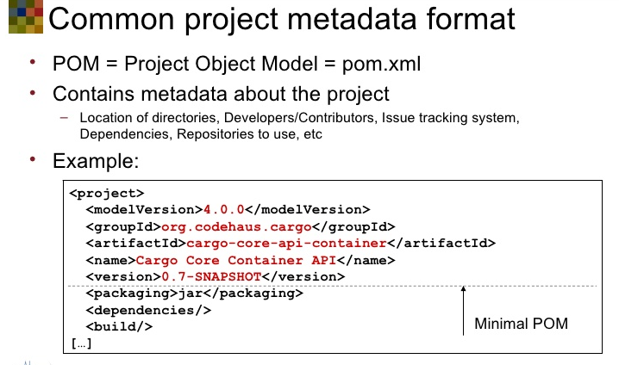

Slide 42
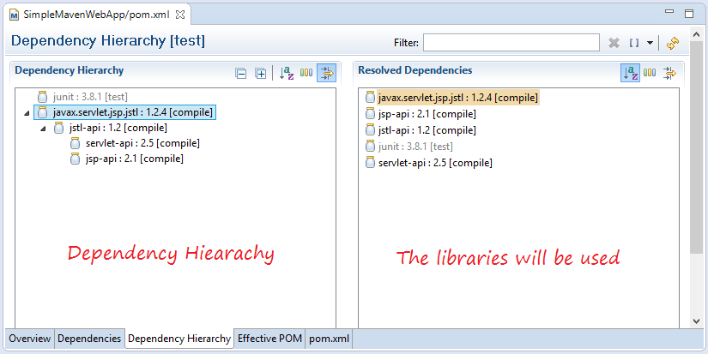

Slide 43
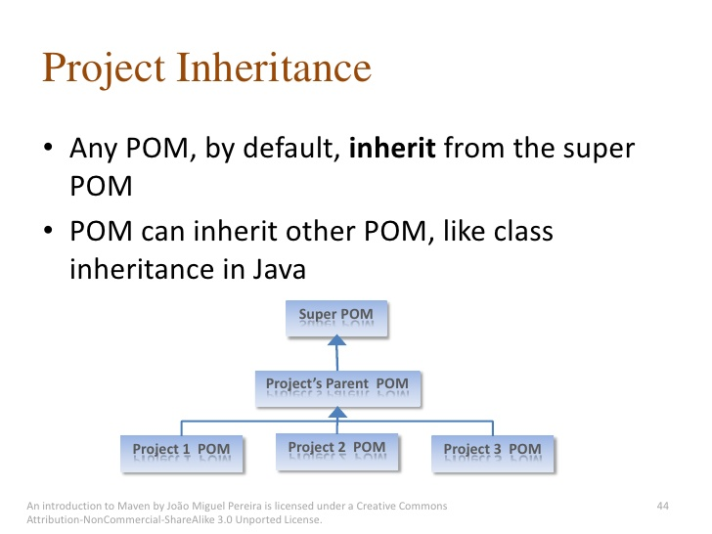

Slide 44
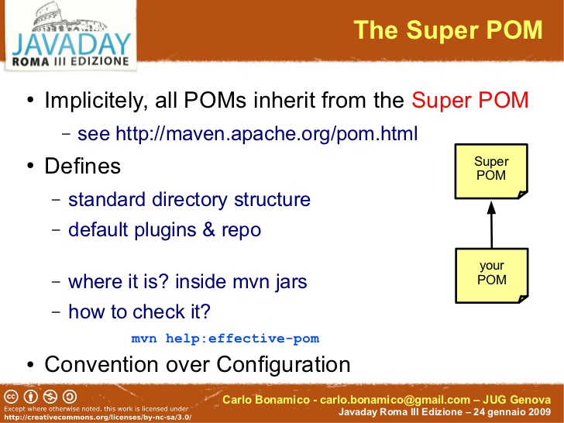
Super POM

Slide 45
Conclusion
Maven is build tool
It help to create project with jars & plugins
Create build and help to deploy
It’s a part of DevOps
CI & CD by Jenkins- its also part of DevOps
GitHub for version control –also use in DevOps environment

Slide 46

Thanks

